Slide 1



LINQ
Language Integrated Query
SoftUni Team
Technical Trainers
Software University
https://softuni.bg

Slide 2
Table of Contents
LINQ
Filtering
Aggregation
SelectMany
Except
Result Models
2

Slide 3
Have a Question?
sli.do
#csharp-db

Slide 4
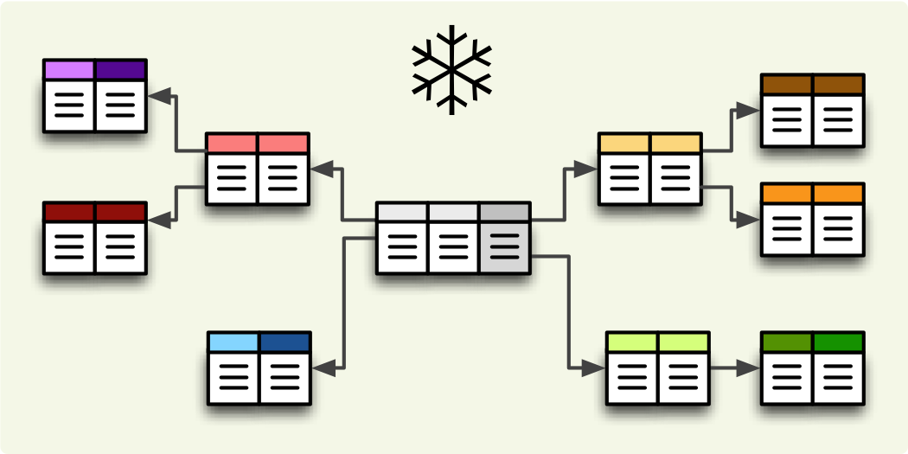
Filtering and Aggregating Tables
Select, Join and Group Data Using LINQ

Slide 5
Filtering
Where
Selects values that are based on a predicate function
Syntax:
string[] words = { "the", "quick", "brown", "fox", "jumps" };
IEnumerable<string> query = from word in words
where word.Length == 3
select word;

Slide 6
Good Reasons to Use Select
Limit network traffic by reducing the queried columns
Syntax:
SQL Server Profiler
var employeesWithTown = context
.Employees
.Select(employee => new
{
EmployeeName = employee.FirstName,
TownName = employee.Address.Town.Name
});
SELECT [employee].[FirstName] AS [EmployeeName], [employee.Address.Town].[Name] AS [TownName]
FROM [Employees] AS [employee]
LEFT JOIN [Addresses] AS [employee.Address] ON [employee].[AddressID] = [employee.Address].[AddressID]
LEFT JOIN [Towns] AS [employee.Address.Town] ON [employee.Address].[TownID] = [employee.Address.Town].[TownID]

Slide 7
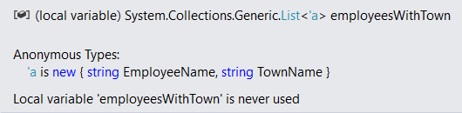
Good Reasons Not to Use Select
Data that is selected is not of the initial entity type
Anonymous type, generated at runtime
Data cannot be modified (updated, deleted)
Entity is of a different type
Not associated with the context anymore

Slide 8
Aggregation
Aggregate functions perform calculations on a set of input values and return a value
Average - Calculates the average value of a collection of values
Count - Counts the elements in a collection, optionally only those elements that satisfy a predicate function
Max and Min - Determine the maximum and the minimum value in a collection
Sum - Calculates the sum of the values in a collection

Slide 9
Joining Tables in EF: Using Join()
Join tables in EF with LINQ / extension methods on IEnumerable<T> (like when joining collections)
var employees =
softUniEntities.Employees.Join(
softUniEntities.Departments,
(e => e.DepartmentID),
(d => d.DepartmentID),
(e, d) => new {
Employee = e.FirstName,
JobTitle = e.JobTitle,
Department = d.Name
}
);

Slide 10
Grouping Tables in EF
Grouping also can be done by LINQ
The same way as with collections in LINQ
Grouping with LINQ:
Grouping with extension methods:
var groupedEmployees =
from employee in softUniEntities.Employees
group employee by employee.JobTitle;
var groupedCustomers = softUniEntities.Employees
.GroupBy(employee => employee.JobTitle);

Slide 11
SelectMany - Example (1)
public class PhoneNumber
{
public string Number { get; set; }
}
public class Person
{
public IEnumerable<PhoneNumber> PhoneNumbers { get; set; }
public string Name { get; set; }
}

Slide 12
SelectMany - Example (2)
IEnumerable<Person> people = new List<Person>();
// "Select" gets a list of lists of phone numbers
IEnumerable<IEnumerable<PhoneNumber>> phoneLists =
people.Select(p => p.PhoneNumbers);
// SelectMany flattens it to just a list of phone numbers.
IEnumerable<PhoneNumber> phoneNumbers =
people.SelectMany(p => p.PhoneNumbers);
// To include data from the parent in the result pass an expression // to the second parameter (resultSelector) in the overload:
var directory = people.SelectMany(p => p.PhoneNumbers,
(parent, child) => new { parent.Name, child.Number });

Slide 13
Except Method
Produces the set difference of two sequences
List<int> setOfNumbers = new List<int> { 1, 2, 3, 4, 5, 6 };
List<int> setOfNumber2 = new List<int> { 1, 3, 5, 8, 9, 10 };
IEnumerable<int> result = setOfNumbers.Except(setOfNumber2);

Slide 14
IEnumerable
IEnumerable is an interface that is available in the System.Collection namespace
Type of iteration design pattern
IEnumerable interface has also a child generic interface i.e. IEnumerable<T>
IEnumerable or IEnumerable<T> interface should be used only for in-memory data objects

Slide 15
IQueryable
IQueryable is an interface and it is available in the System.Linq namespace
The IQuerable interface is a child of the IEnumerable interface
We can store IQuerable in a variable of type IEnumerable
Provider
IQueryProvider is used to create all Linq Providers
To return a collection of type IQueryable:
AsQueryable()

Slide 16
IQueryable
IQueryable is an interface and it is available in System.Linq namespace
Provides functionality to evaluate queries against a specific data source where the type of the data is not specified
The IQueryable interface is intended for implementation by query providers
The IQueryable interface inherits the IEnumerable interface

Slide 17
Differences Between IEnumerable and IQueryable
IEnumerable
System.Collections
There is no base interface
Selects query on the server-side -> loads data in-memory on the client-side -> and then filters the data
IQueryable
System.Linq
Derives the base interface from IEnumerable
Selects query on the server-side with the help of its filters

Slide 18

Result Models
Simplifying Models

Slide 19
Result Models
Select(), GroupBy() can work with custom classes
Allow you to pass them to methods and use them as a return type
Require some extra code (class definition)
Sample Result Model:
public class UserResultModel
{
public string FullName { get; set; }
public string Age { get; set; }
}
19

Slide 20
Result Models (2)
Assign the fields as you would with an anonymous object:
The new type can be used in a method signature:
var currentUser = context.Users
.Where(u => u.Id == 8)
.Select(u => new UserResultModel
{
FullName = u.FirstName + " " + u.LastName,
Age = u.Age
})
.SingleOrDefault();
public UserResultModel GetUserInfo(int Id) { … }

Slide 21

Summary
…
…
…
LINQ
Filtering, Aggregation, SelectMany, Except
IEnumerable
IQueryable
Differences Between IEnumerable and IQueryable
Result Models

Slide 22
Questions?
Notes:
22

Slide 23

License
This course (slides, examples, demos, exercises, homework, documents, videos and other assets) is copyrighted content
Unauthorized copy, reproduction or use is illegal
© SoftUni – https://about.softuni.bg
© Software University – https://softuni.bg
Notes:
23

Slide 24
Trainings @ Software University (SoftUni)
Software University – High-Quality Education, Profession and Job for Software Developers
softuni.bg, about.softuni.bg
Software University Foundation
softuni.foundation
Software University @ Facebook
facebook.com/SoftwareUniversity
Software University Forums
forum.softuni.bg
24
Notes:
24

